Slide 1
Mapping functional conformations of the lac repressor
Anum Glasgow
2020 09 30

Slide 2
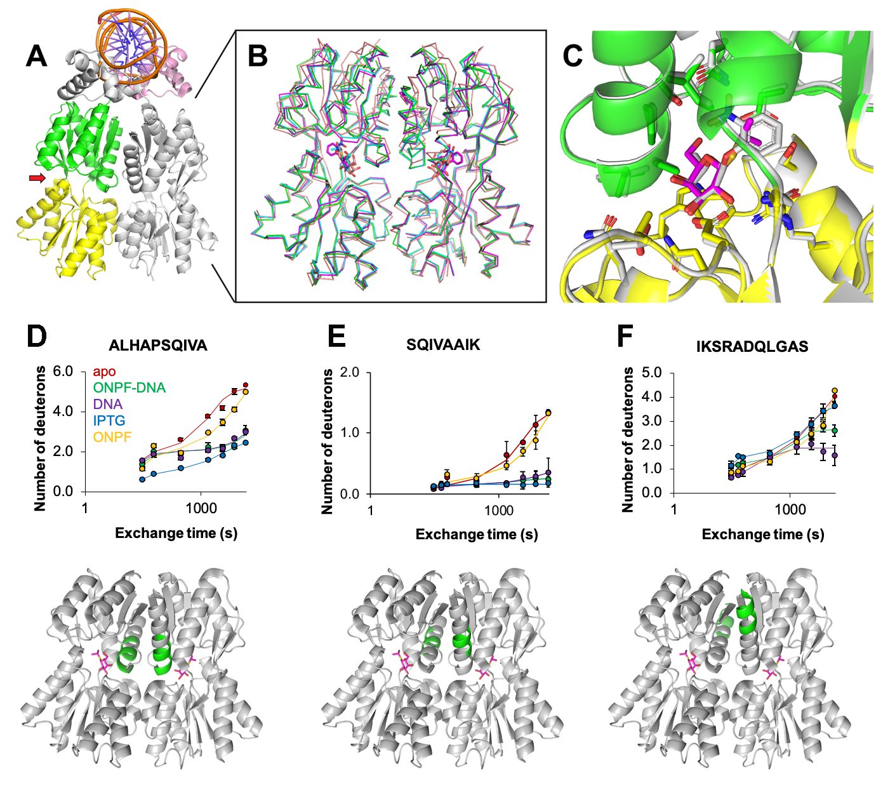

Slide 3
IPTG-bound state

Slide 4
IPTG-bound state

Slide 5
IPTG-bound state
DNA-bound state
all heavy atom RMSD, C-term. subdomain: 0.66 Å
non-DNA-bound states
DNA-bound states

Slide 6
IPTG-bound state
DNA-bound state
all heavy atom RMSD, C-term. subdomain: 0.66 Å
apo & inducers

Slide 7
IPTG-bound state
DNA-bound state
all heavy atom RMSD, C-term. subdomain: 0.66 Å
DNA-bound states

Slide 8
The two states with the strongest opposite effects on gene expression are:
ONPF-DNA (no transcription) and
IPTG (transcription).
Overall, LacI is much more rigid in the ONPF-DNA state. Binding a large DNA molecule is stabilizing.
However, there are 3 structural regions that are more rigid in the IPTG state, shown in magenta.
Is the rigidification of these secondary structures required for inducing gene expression?

Slide 10
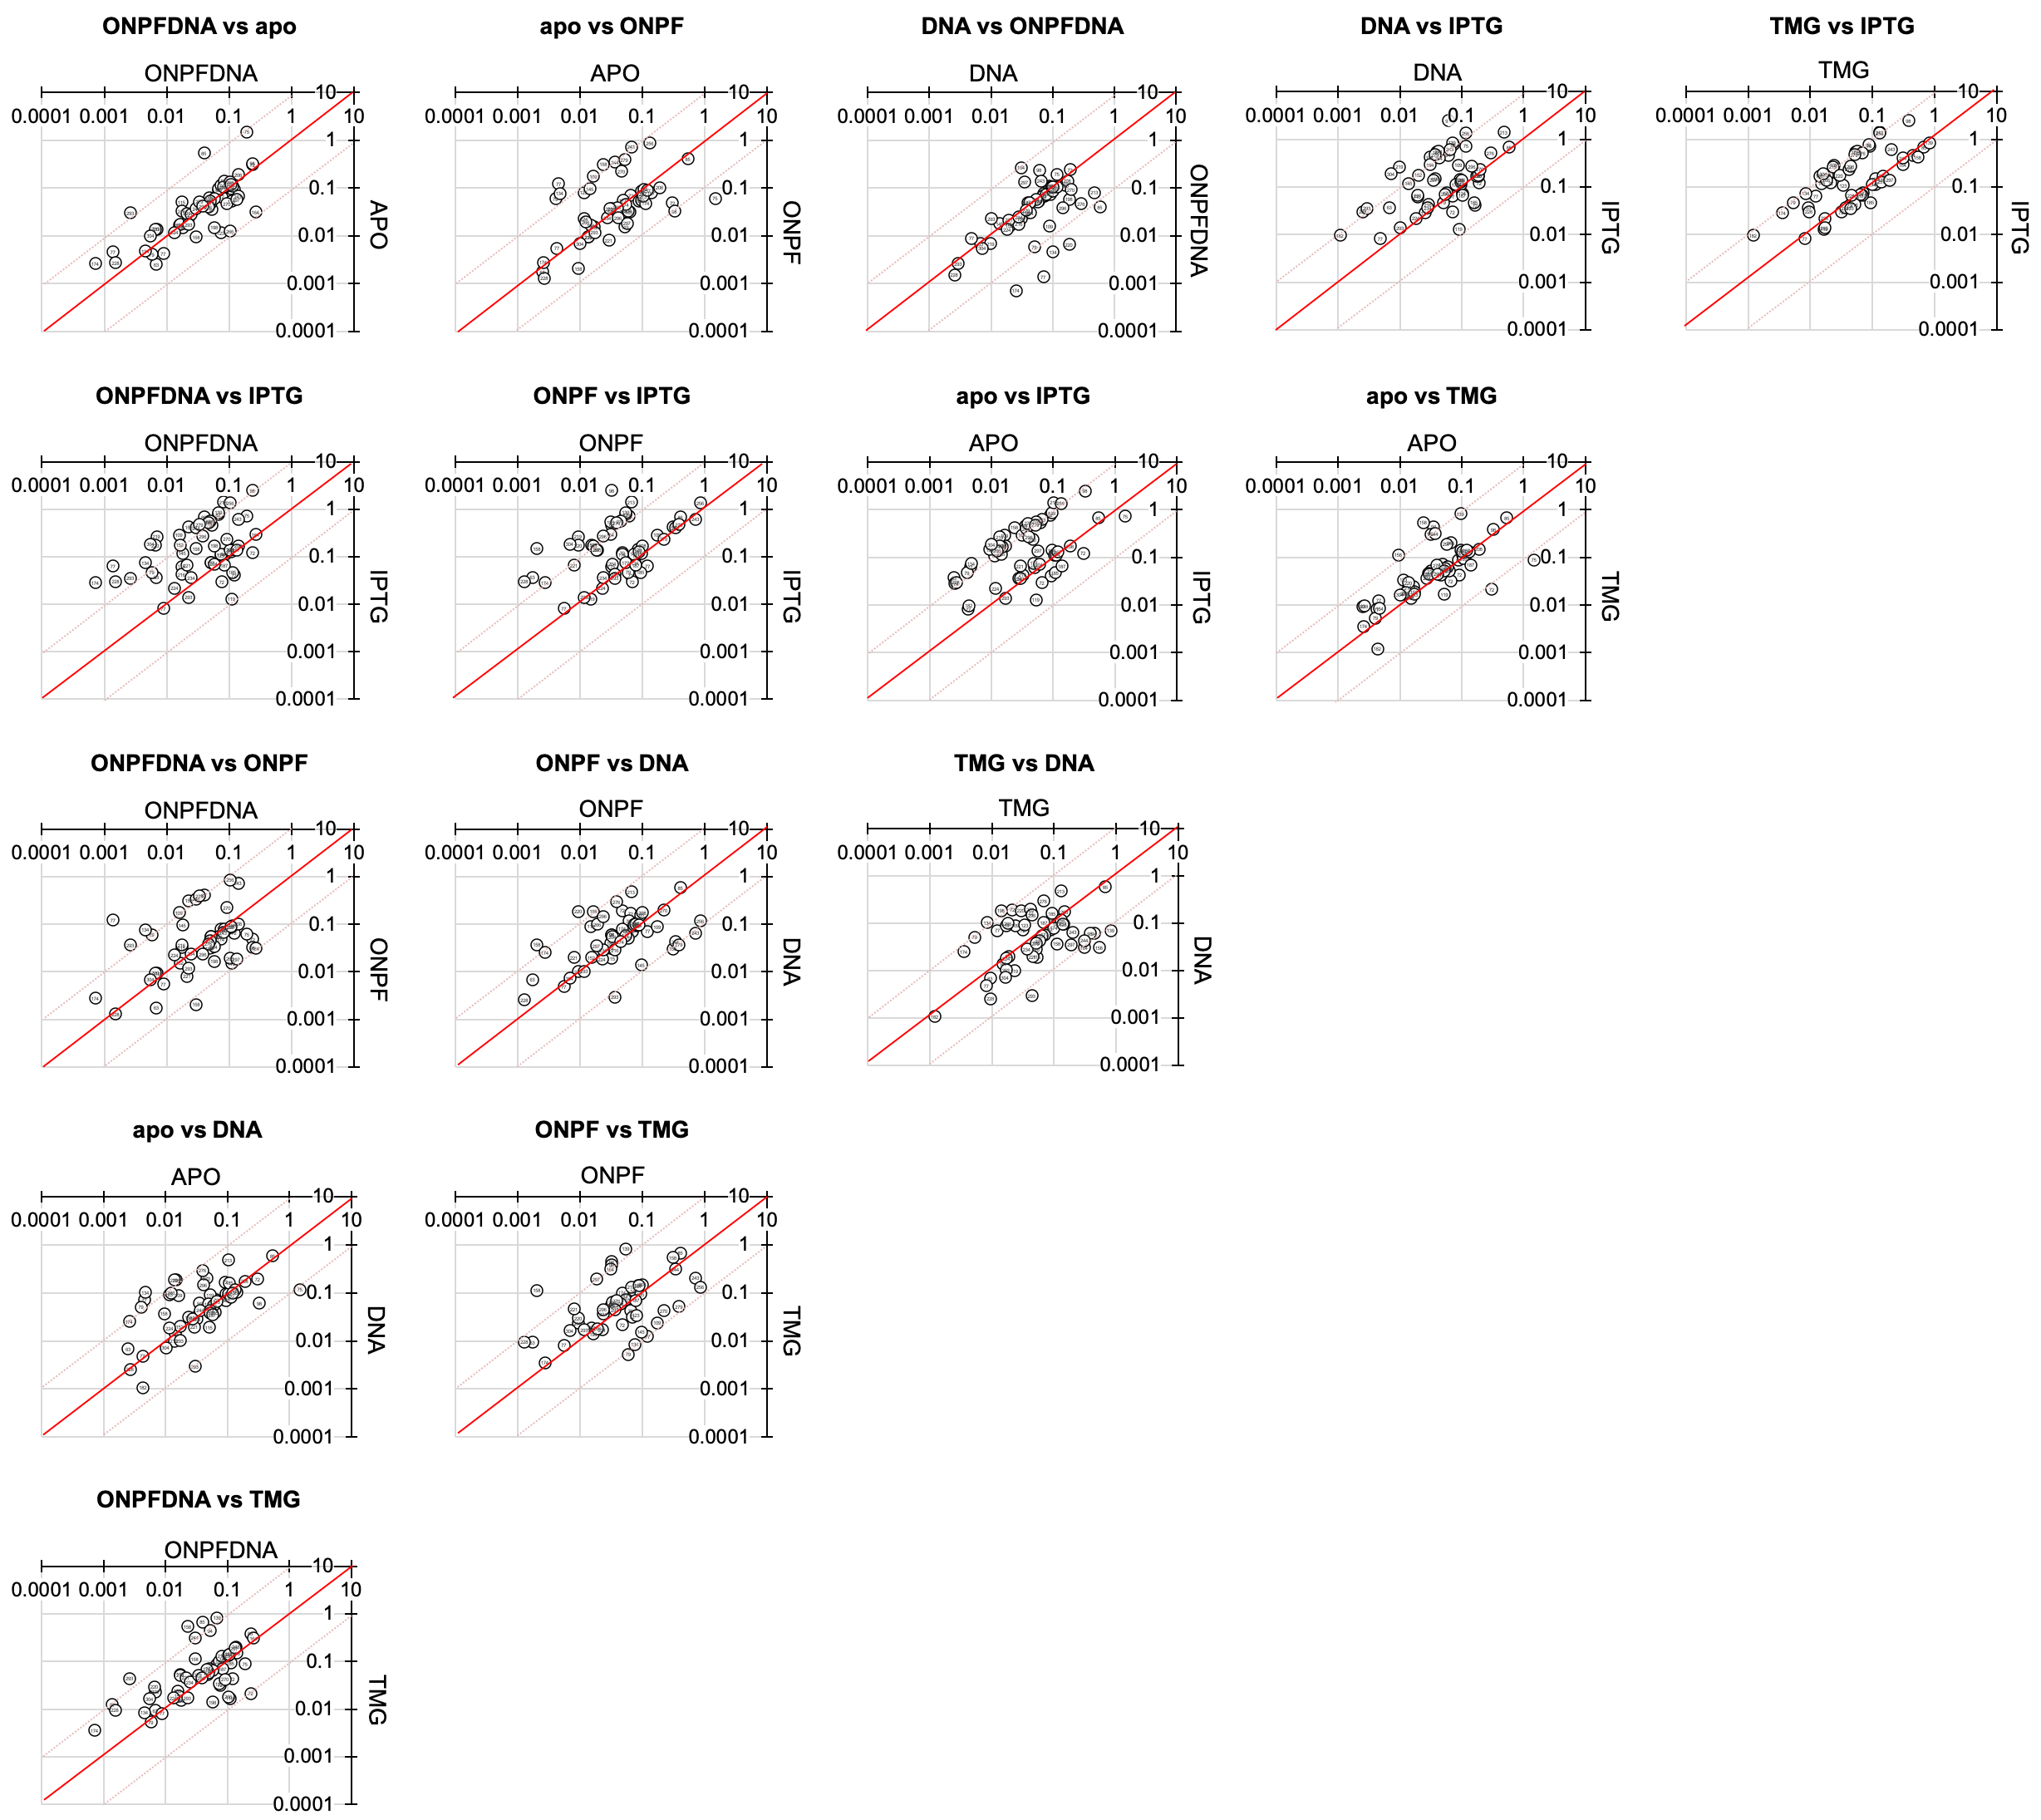

ALL
NO NON-EXCHANGING

Slide 11

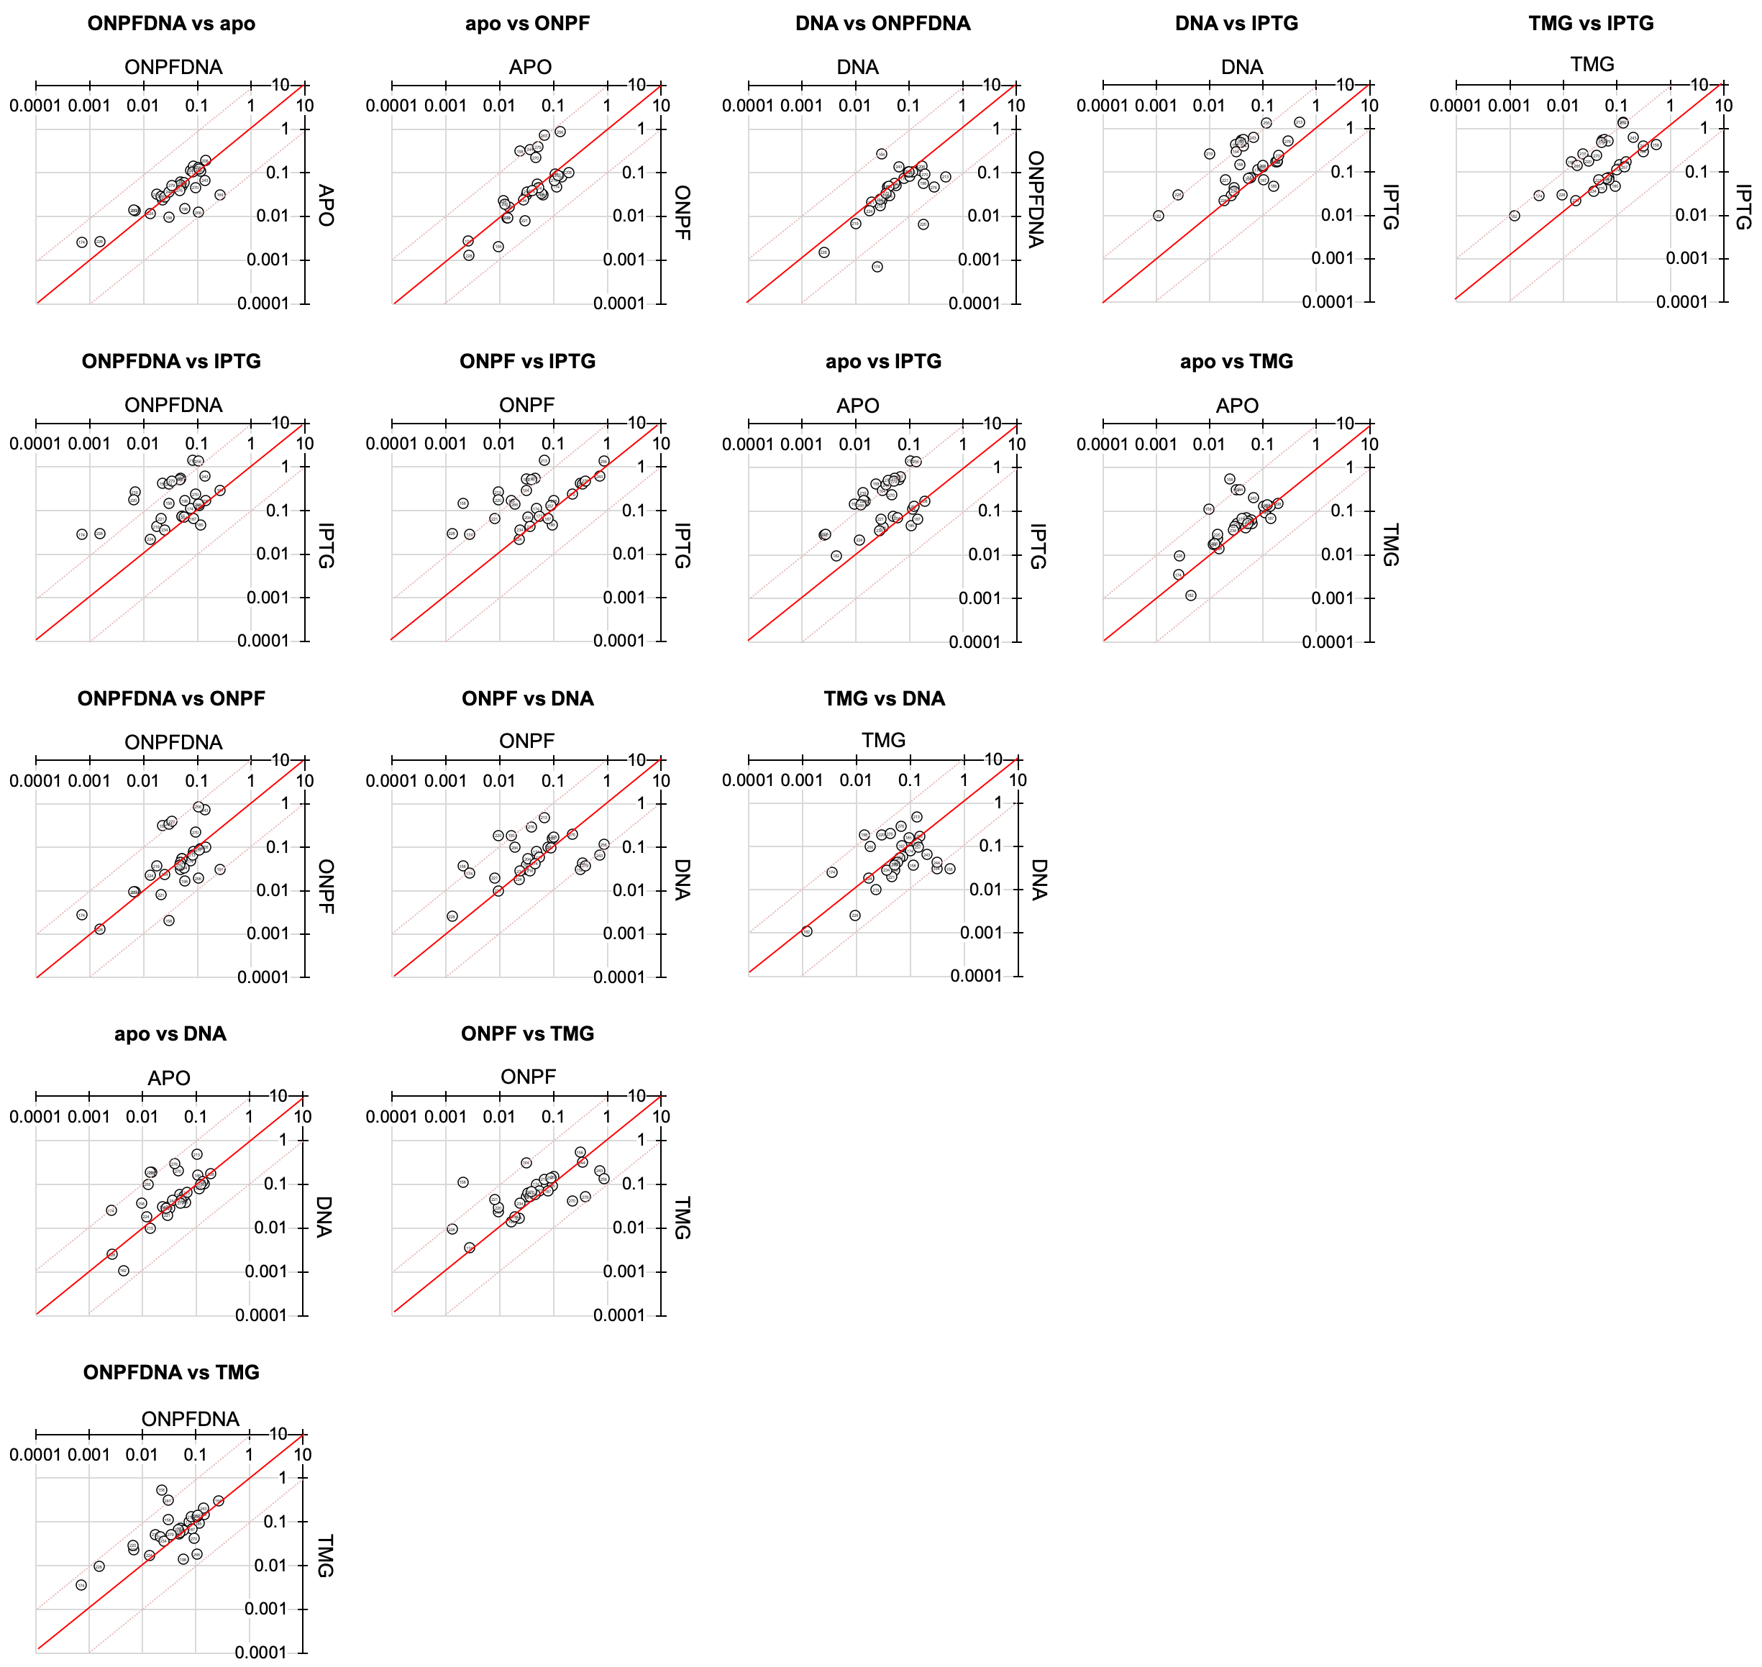
N-TERM SUBDOMAIN
C-TERM SUBDOMAIN

Slide 12
